Slide 1
Murach’s C# (8th Edition)
Chapter 10
More skills for working
with Windows forms
and controls

Slide 2
Objectives
Applied
Given the specifications for a form that uses any of the controls presented in this chapter, design and code the form.
Given a form with two or more controls, set the tab order of the controls using the Tab Order view of the form.
Given the specifications for an app that displays custom or standard dialogs, design and code the app.

Slide 3
Objectives (continued)
Knowledge
In general terms, describe the use of these controls: combo box, list box, radio button, check box, and group box.
Explain how the refactoring feature helps you change some of the occurrences of the form name in the code, but not the occurrences in the event handlers for the form.
Describe the way the Program class for an app displays the first form of an app.
Explain what global using directives are and where they’re usually stored.
Describe how you can use the DialogResult enumeration and the Tag property to pass data between a form and a custom dialog.
Describe how you can use the FormClosing event to stop a form from closing.

Slide 4
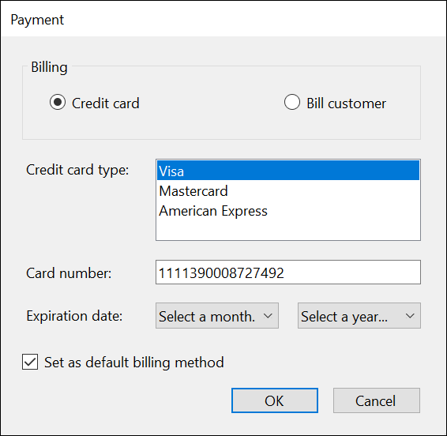
A form with five more types of controls

Slide 5
Common properties of list box and combo box controls
SelectedIndex
SelectedItem
Text
Sorted
Items
DropDownStyle
SelectionMode

Slide 6
Common events of list box and combo box controls
SelectedIndexChanged
TextChanged

Slide 7
A common property of the Items collection
Count

Slide 8
Common methods of the Items collection
Add
Insert
Remove
RemoveAt
Clear

Slide 9
Code that loads a combo box with months
string[] months =
{"Select a month...",
"January", "February", "March", "April",
"May", "June", "July", "August",
"September", "October", "November", "December"};
foreach (string month in months)
{
cboExpirationMonth.Items.Add(month);
}

Slide 10
Code that loads a combo box with years
int year = DateTime.Today.Year;
int endYear = year + 8;
cboExpirationYear.Items.Add("Select a year...");
while (year < endYear)
{
cboExpirationYear.Items.Add(year);
year++;
}

Slide 11
Code that clears and loads a list box of credit cards
lstCreditCardType.Items.Clear();
lstCreditCardType.Items.Add("Visa");
lstCreditCardType.Items.Add("Mastercard");
lstCreditCardType.Items.Add("American Express");
lstCreditCardType.SelectedIndex = 0;
// select first item

Slide 12
Statements that get information from a combo box or list box
int expYearIndex = cboExpirationYear.SelectedIndex;
string expYearText = cboExpirationYear.Text;
int expYearValue =
(int) cboExpirationYear.SelectedItem ?? -1;
string expMonthValue =
cboExpirationMonth.Items[1].ToString();

Slide 13
Code that works with a combo box of names
string[] names = {
"Judy Taylor", "Anne Boehm", "Kelly Slivkoff"};
foreach (string name in names)
{
cboNames.Items.Add(name);
}
cboNames.Items.Insert(0, "Joel Murach");
cboNames.Items.RemoveAt(3);
cboNames.SelectedIndex = -1; // don't select an item

Slide 14

A group box that contains two radio buttons

Slide 15
Code that sets the value of a radio button and check box
rdoCreditCard.Checked = true;
chkDefault.Checked = true;

Slide 16
Code that checks the value of a radio button
private void rdoCreditCard_CheckedChanged(
object sender, EventArgs e)
{
if (rdoCreditCard.Checked == true)
EnableControls();
else
DisableControls();
}

Slide 17
Code that gets the value of a check box
bool isDefaultBilling = chkDefault.Checked;

Slide 18
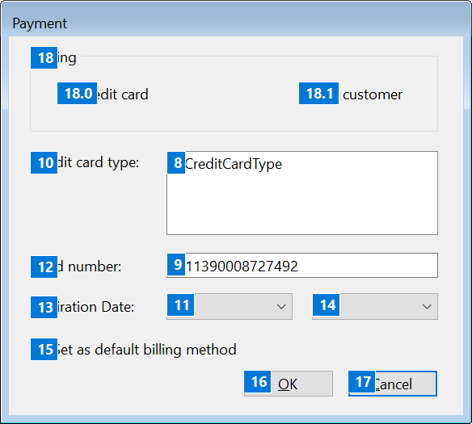
A form in Tab Order view before the tab order is changed

Slide 19
How to use Tab Order view to change the tab order
To display a form in Tab Order view, select it and then select the View→Tab Order command.
To change the tab indexes of the controls, click on the controls in the sequence you want to use.
To change the sub indexes of the controls in a group box, click on them individually.

Slide 20
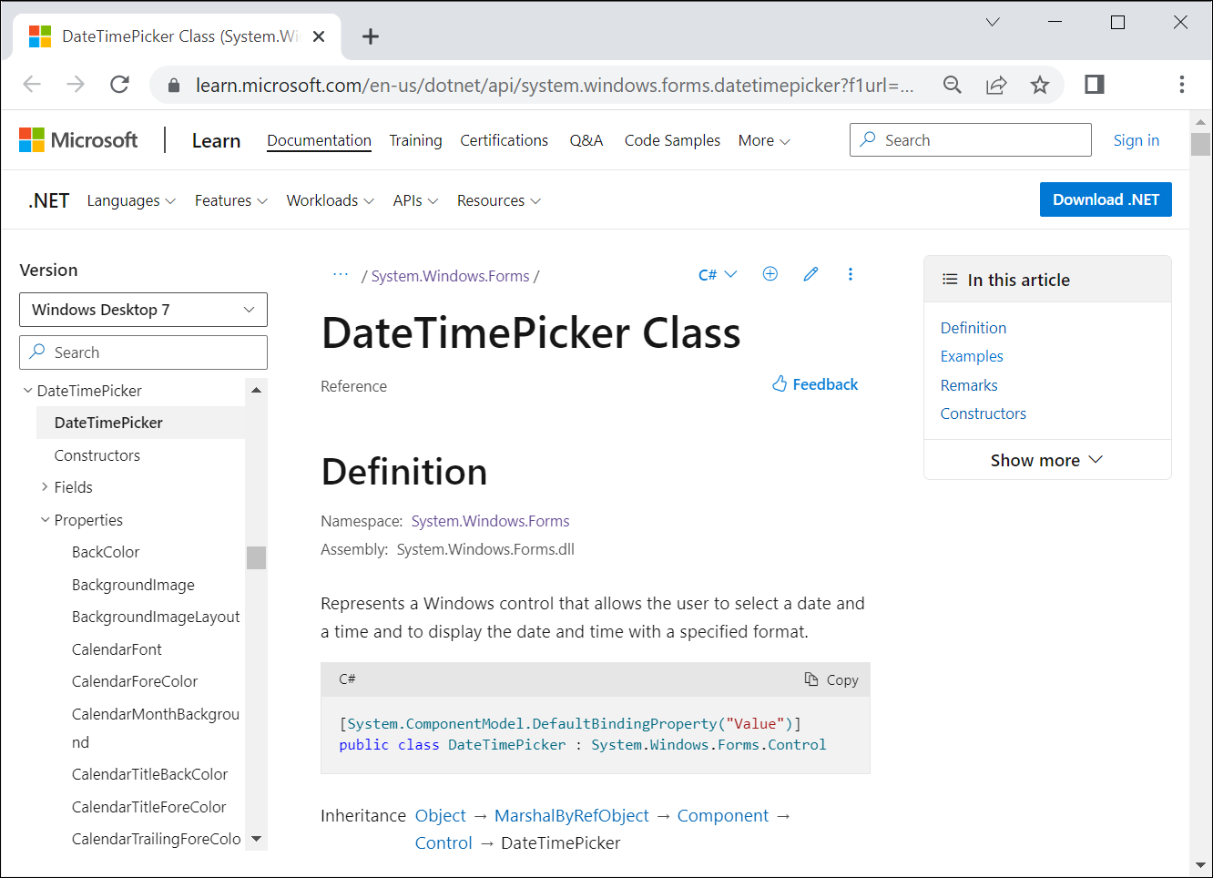
Help for the DateTimePicker class

Slide 21
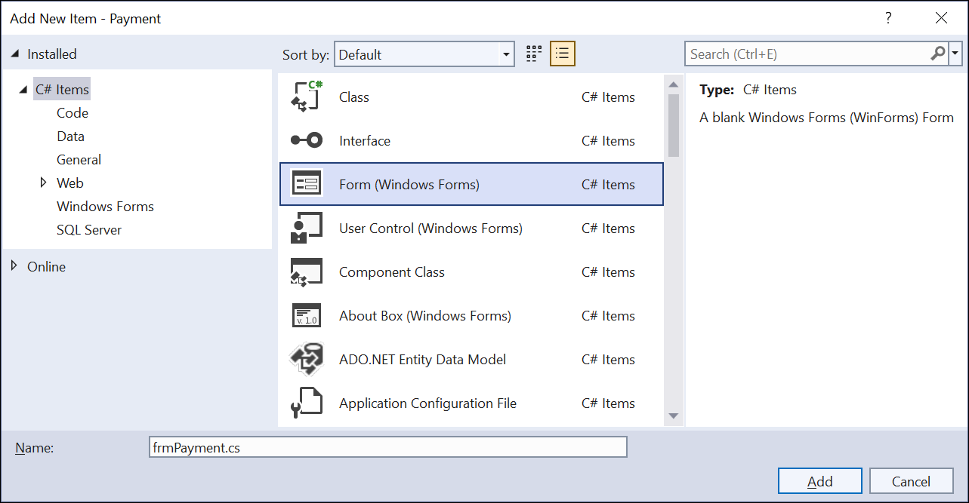
The Add New Item dialog

Slide 22
The generated code for a new form named frmPayment
For the frmPayment.cs file
namespace Payment;
public partial class frmPayment : Form
{
public frmPayment()
{
InitializeComponent();
}
}

Slide 23
The generated code for a new form (continued)
For the frmPayment.Designer.cs file
namespace Payment;
partial class frmPayment
{
private System.ComponentModel.IContainer components =
null;
protected override void Dispose(bool disposing)
{
if (disposing && (components != null))
{
components.Dispose();
}
base.Dispose(disposing);
}
#region Windows Form Designer generated code
}

Slide 24
The code that’s generated for the Load event handler of the form
The method declaration in the frmPayment.cs file
private void frmPayment_Load(object sender, EventArgs e)
{
}
The wiring in the frmPayment.Designer.cs file
Load += frmPayment_Load;

Slide 25
The code for a global using directive
global using System.Collections;

Slide 26
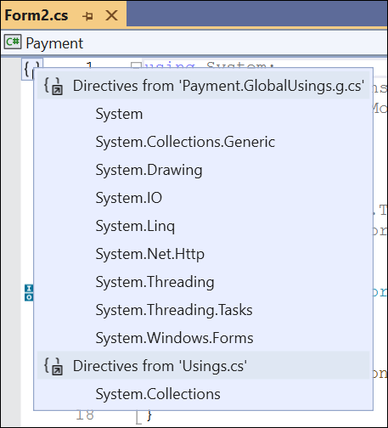
Global using directives for a Windows Forms app

Slide 27
How to view the global using directives for an app
Hover over the icon in the upper left corner of a class file to display a tooltip that says Global ‘using’ directives.
Click on the icon to view all global using directives listed by the names of the files that contain them.

Slide 28
The using directives Visual Studio generates by default for a new form
using System;
using System.Collections.Generic;
using System.ComponentModel;
using System.Data;
using System.Drawing;
using System.Linq;
using System.Text;
using System.Threading.Tasks;
using System.Windows.Forms;

Slide 29
How to remove unused using directives
Click on or hover over one of the using directives.
Click on the yellow light bulb that appears, then click on Remove Unnecessary Usings.

Slide 30
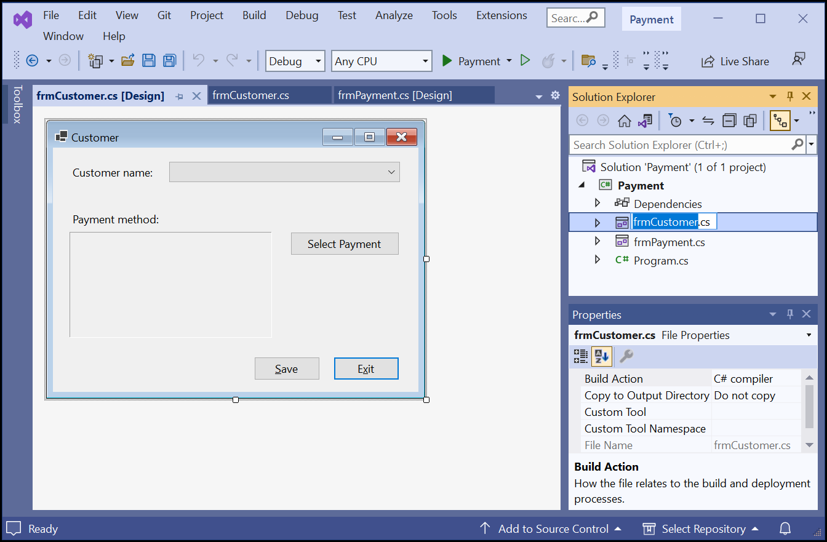
A project that contains two forms

Slide 31
Code that defines the main entry point for an app
namespace Payment;
internal static class Program
{
/// <summary>
/// The main entry point for the application.
/// </summary>
[STAThread]
static void Main()
{
// To customize application configuration such as
// set high DPI settings or default font,
// see https://aka.ms/applicationconfiguration.
ApplicationConfiguration.Initialize();
Application.Run(new frmCustomer());
}
}

Slide 32
The Payment form displayed as a dialog

Slide 33
Properties for creating custom dialogs
ControlBox
MaximizeBox
MinimizeBox

Slide 34
Code that creates and displays a custom dialog
Form paymentForm = new frmPayment();
paymentForm.ShowDialog();
// execution continues here after the user responds
// to the dialog

Slide 35
How to set two properties of a form
A statement that sets the DialogResult property
DialogResult = DialogResult.OK;
A statement that sets the Tag property
Tag = msg;

Slide 36
Code that uses the result of a dialog and the Tag property
Form paymentForm = new frmPayment();
DialogResult result = paymentForm.ShowDialog();
if (result == DialogResult.OK)
lblPayment.Text = paymentForm.Tag?.ToString();

Slide 37
A statement that displays a dialog and gets the user response
DialogResult button =
MessageBox.Show(
"Are you sure you want to save this data?",
"Payment",
MessageBoxButtons.YesNo,
MessageBoxIcon.Question,
MessageBoxDefaultButton.Button2);

Slide 38
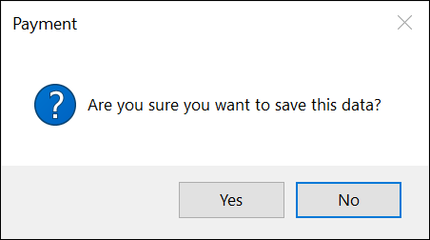
The dialog that gets the user’s response

Slide 39
A statement that checks the user response
if (button == DialogResult.Yes)
{
SaveData();
isDataSaved = true;
}

Slide 40
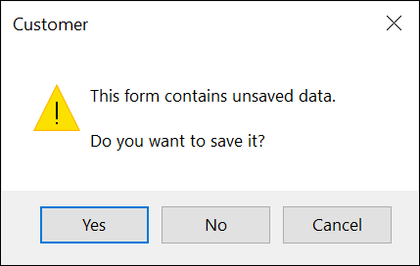
The dialog for saving or not saving a form

Slide 41
The code for a dialog that can cancel the Closing event
private void frmCustomer_FormClosing(
object sender, FormClosingEventArgs e)
{
if (isDataSaved == false)
{
string message =
"This form contains unsaved data.\n\n" +
"Do you want to save it?";
DialogResult button =
MessageBox.Show(message, "Customer",
MessageBoxButtons.YesNoCancel,
MessageBoxIcon.Warning);

Slide 42
The code for a dialog that can cancel the Closing event (continued)
if (button == DialogResult.Yes)
{
if (IsValidData())
SaveData();
else
e.Cancel = true;
}
if (button == DialogResult.Cancel)
{
e.Cancel = true;
}
}
}

Slide 43
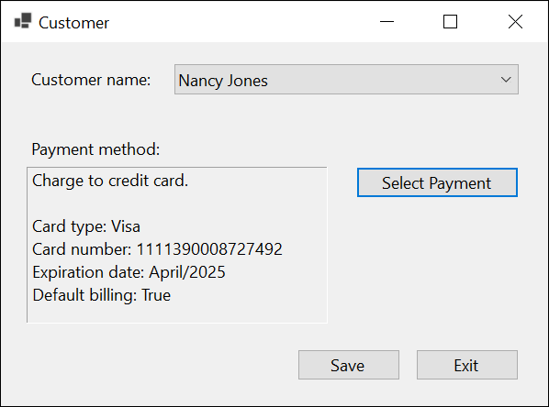
The Customer form

Slide 44
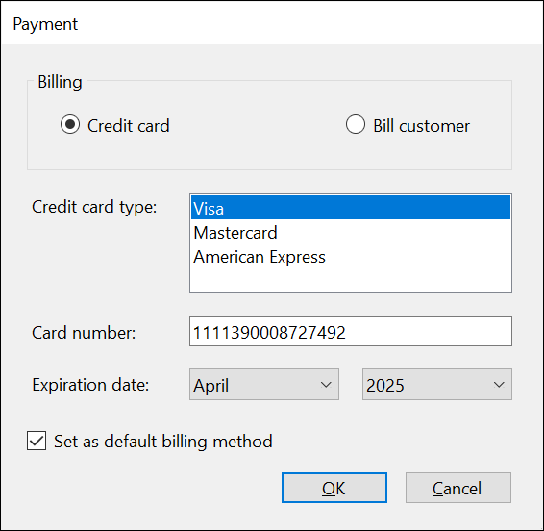
The Payment dialog for a credit card payment

Slide 45
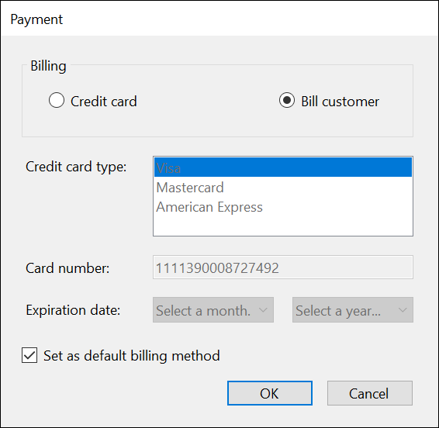
The Payment dialog for billing a customer

Slide 46
The code for the Customer form (part 1)
public partial class frmCustomer : Form
{
public frmCustomer()
{
InitializeComponent();
}
bool isDataSaved = true;
private void frmCustomer_Load(
object sender, EventArgs e)
{
cboNames.Items.Add("Mike Smith");
cboNames.Items.Add("Nancy Jones");
}
private void lblPayment_TextChanged(
object sender, EventArgs e)
{
isDataSaved = false;
}

Slide 47
The code for the Customer form (part 2)
private void cboNames_SelectedIndexChanged(
object sender, EventArgs e)
{
isDataSaved = false;
lblPayment.Text = "";
}
private void btnSelectPayment_Click(
object sender, EventArgs e)
{
Form paymentForm = new frmPayment();
DialogResult selectedButton =
paymentForm.ShowDialog();
if (selectedButton == DialogResult.OK)
{
lblPayment.Text = paymentForm.Tag?.ToString();
}
}

Slide 48
The code for the Customer form (part 3)
private void btnSave_Click(object sender, EventArgs e)
{
if (IsValidData())
{
SaveData();
}
}
private void SaveData()
{
cboNames.SelectedIndex = -1;
lblPayment.Text = "";
isDataSaved = true;
cboNames.Focus();
}

Slide 49
The code for the Customer form (part 4)
private bool IsValidData()
{
bool success = true;
string errorMessage = "";
if (cboNames.SelectedIndex == -1)
{
errorMessage +=
"You must select a customer.\n";
}
if (lblPayment.Text == "")
{
errorMessage += "You must enter a payment.\n";
}
if (errorMessage != "")
{
success = false;
MessageBox.Show(errorMessage, "Entry Error");
}
return success;
}

Slide 50
The code for the Customer form (part 5)
private void btnExit_Click(object sender, EventArgs e)
{
Close();
}
private void frmCustomer_FormClosing(object sender,
FormClosingEventArgs e)
{
if (isDataSaved == false)
{
string message =
"This form contains unsaved data.\n\n" +
"Do you want to save it?";
DialogResult button =
MessageBox.Show(message, "Customer",
MessageBoxButtons.YesNoCancel,
MessageBoxIcon.Warning); }

Slide 51
The code for the Customer form (part 6)
if (button == DialogResult.Yes) {
if (IsValidData())
SaveData();
else
e.Cancel = true;
}
if (button == DialogResult.Cancel) {
e.Cancel = true;
}
}
}
}

Slide 52
The code for the Payment form (part 1)
public partial class frmPayment : Form
{
public frmPayment()
{
InitializeComponent();
}

Slide 53
The code for the Payment form (part 2)
private void frmPayment_Load(
object sender, EventArgs e)
{
lstCreditCardType.Items.Add("Visa");
lstCreditCardType.Items.Add("Mastercard");
lstCreditCardType.Items.Add("American Express");
lstCreditCardType.SelectedIndex = 0;
string[] months = {"Select a month...",
"January", "February", "March", "April",
"May", "June", "July", "August",
"September", "October", "November", "December"};
foreach (string month in months)
{
cboExpirationMonth.Items.Add(month);
}
cboExpirationMonth.SelectedIndex = 0;

Slide 54
The code for the Payment form (part 3)
int year = DateTime.Today.Year;
int endYear = year + 8;
cboExpirationYear.Items.Add("Select a year...");
while (year < endYear)
{
cboExpirationYear.Items.Add(year);
year++;
}
cboExpirationYear.SelectedIndex = 0;
}
private void btnOK_Click(object sender, EventArgs e)
{
if (IsValidData())
{
SaveData();
}
}

Slide 55
The code for the Payment form (part 4)
private bool IsValidData()
{
bool success = true;
if (rdoCreditCard.Checked)
{
string errorMessage = "";
if (lstCreditCardType.SelectedIndex == -1)
{
errorMessage +=
"Select a credit card type.\n";
}
if (txtCardNumber.Text == "")
{
errorMessage +=
"Enter a credit card number.\n";
}

Slide 56
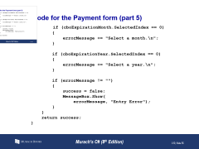
The code for the Payment form (part 5)
if (cboExpirationMonth.SelectedIndex == 0)
{
errorMessage += "Select a month.\n";
}
if (cboExpirationYear.SelectedIndex == 0)
{
errorMessage += "Select a year.\n";
}
if (errorMessage != "")
{
success = false;
MessageBox.Show(
errorMessage, "Entry Error");
}
}
return success;
}

Slide 57
The code for the Payment form (part 6)
private void SaveData()
{ string msg = "";
if (rdoCreditCard.Checked)
{ msg += "Charge to credit card." + "\n\n";
msg += "Card type: " + lstCreditCardType.Text +
"\n";
msg += "Card number: " + txtCardNumber.Text +
"\n";
msg += "Expiration date: "
+ cboExpirationMonth.Text + "/"
+ cboExpirationYear.Text + "\n";
}
else
{ msg += "Send bill to customer." + "\n\n";
}
bool isDefaultBilling = chkDefault.Checked;
msg += "Default billing: " + isDefaultBilling;
Tag = msg;
DialogResult = DialogResult.OK;
}

Slide 58
The code for the Payment form (part 7)
private void Billing_CheckedChanged(
object sender, EventArgs e)
{ if (rdoCreditCard.Checked)
EnableControls();
else
DisableControls();
}
private void EnableControls()
{ lstCreditCardType.Enabled = true;
txtCardNumber.Enabled = true;
cboExpirationMonth.Enabled = true;
cboExpirationYear.Enabled = true;
}
private void DisableControls()
{ lstCreditCardType.Enabled = false;
txtCardNumber.Enabled = false;
cboExpirationMonth.Enabled = false;
cboExpirationYear.Enabled = false;
}
}

